Slide 1


Spring Cloud
Configuring Eureka Server

Slide 2


Agenda
1) Building REST client using Rest Template
2) Introduction to Spring Cloud
3) Configuring Eureka Server

Slide 3
Building REST client using Rest Template
1. Spring RestTemplate class
Accessing the REST apis inside a Spring application revolves around the use of the Spring RestTemplate class. The RestTemplate class is designed on the same principles as the many other Spring *Template classes (e.g., JdbcTemplate, JmsTemplate ), providing a simplified approach with default behaviors for performing complex tasks.
Given that the RestTemplate class is a synchronous client and designed to call REST services. It should come as no surprise that its primary methods are closely tied to REST’s underpinnings, which are the HTTP protocol’s methods HEAD, GET, POST, PUT, DELETE, and OPTIONS.

Slide 4
Using RestTemplateBuilder
RestTemplateBuilder based configuration
@Bean
public RestTemplate restTemplate(RestTemplateBuilder builder) {
return builder
.setConnectTimeout(Duration.ofMillis(3000))
.setReadTimeout(Duration.ofMillis(3000))
.build();
}

Slide 5
Using SimpleClientHttpRequestFactory
SimpleClientHttpRequestFactory based configuration
@Bean
public RestTemplate restTemplate() {
var factory = new SimpleClientHttpRequestFactory();
factory.setConnectTimeout(3000);
factory.setReadTimeout(3000);
return new RestTemplate(factory);
}

Slide 6
Introduction to Spring Cloud
Spring Cloud provides tools for developers to quickly build some of the common patterns in distributed systems (e.g. configuration management, service discovery, circuit breakers, intelligent routing, micro-proxy, control bus, one-time tokens, global locks, leadership election, distributed sessions, cluster state).
Coordination of distributed systems leads to boiler plate patterns, and using Spring Cloud developers can quickly stand up services and applications that implement those patterns.
They will work well in any distributed environment, including the developer’s own laptop, bare metal data centres, and managed platforms such as Cloud Foundry.

Slide 7
What are Microservices?
A microservice, also known as the microservice architecture, is an architectural style that structures an application as a collection of services. Benefits of the microservice architecture are as follows:
► Small modules
► Loosely coupled
► Independently deployable
► Faster defect isolation
The microservice architecture enables the rapid, frequent, and reliable delivery of large, complex applications. It also enables an organization to evolve its technology stack. Apart from this, the microservice architecture helps us to achieve continuous delivery and integration.

Slide 8
What is Spring Cloud and What is It Used For?
Spring Cloud is a framework for building robust cloud applications and it provides a solution to the commonly encountered patterns when developing a distributed system. Spring Cloud framework provides tools for developers to quickly build both cloud applications and microservice-based applications.
Using Spring Cloud, a developer can quickly develop services and applications that implement the design patterns that work well in any distributed environment. However, Spring Cloud is not a single-unit project, but a group of projects for managing the challenges of development of cloud-native systems. Some important projects are the following:
► Spring Cloud Config
► Spring Cloud Netflix
► Spring Cloud Bus
► Spring Cloud Sleuth
► Spring Cloud Kubernetes

Slide 9
Spring Cloud Netflix is the most popular project that is part of Spring Cloud. It has around 3.5k stars on GitHub. It provides Netflix OSS integrations for Spring Boot apps through auto-configuration and binding to the Spring Environment. With a few simple annotations, you can quickly enable and configure the common patterns inside your application and start building large distributed systems.

Slide 10
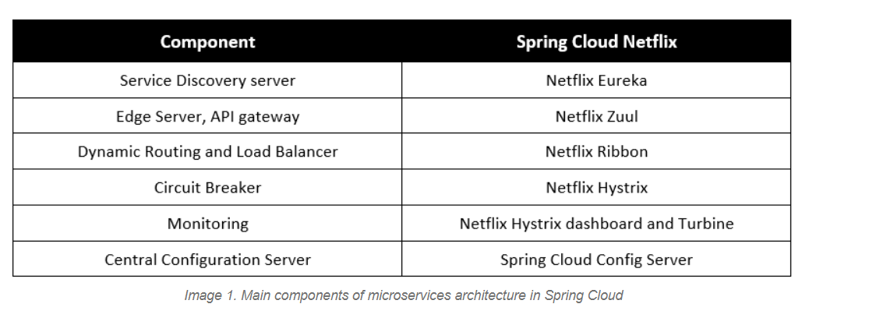

Slide 11
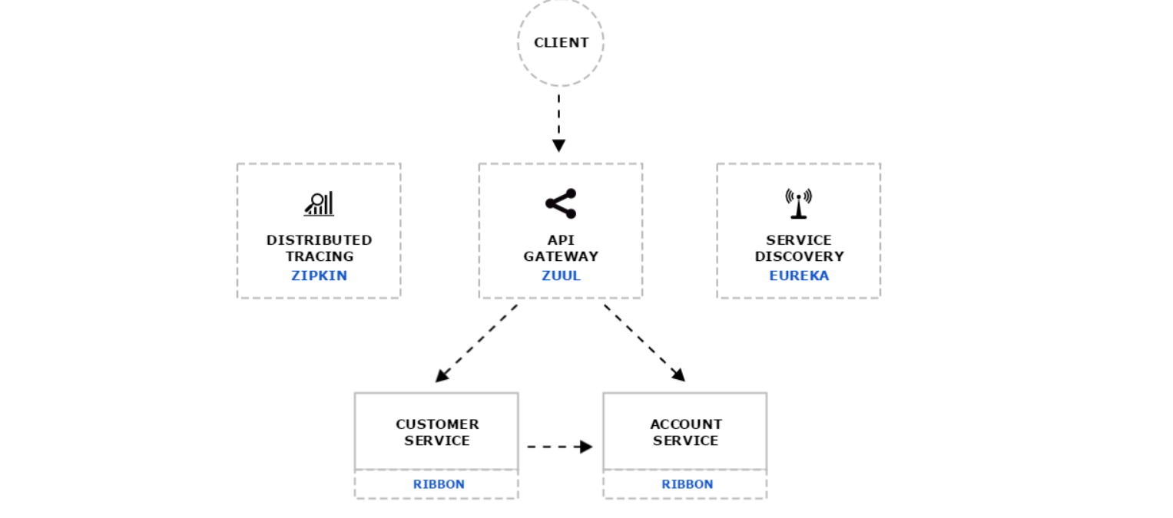

Slide 12
Service Discovery - Netflix Eureka
In distributed computing, there is a concept called Service Discovery and Registration where one dedicated server is responsible for maintaining the registry of all the microservices that have been deployed and removed.
Think of it as a lookup service where microservices (clients) can register themselves and discover other registered microservices. When a client microservice registers with Eureka, it provides metadata such as host, post, and health indicators thus allowing other microservices to discover it. The discovery server expects a regular heartbeat message from each microservice instance. If an instance begins to consistently fail to send a heartbeat, the discovery server will remove the instance from its registry. This way we will have a very stable ecosystem of microservices collaborating with each other. Also, we don’t have to manually maintain the address of other microservices, which is a next to impossible task if the scale up or down is very frequent and we use a virtual host to host the services, especially in the cloud environment.
To create Eureka server, we need to add Eureka Server dependency and annotate Spring Boot’s main class with @EnableEurekaServer.

Slide 13
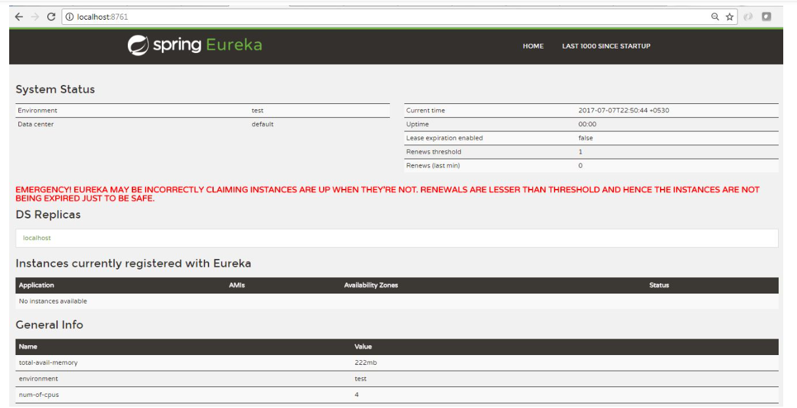

Slide 14
In this case, no service is registered here which is expected and once we spin up the client services, this server will update with the details of the client services. When we want to register a new service instance with the Eureka Server, we need to have Eureka Discovery Client dependency and to annotate Spring Boot’s main class with @EnableEurekaClient.

Slide 15
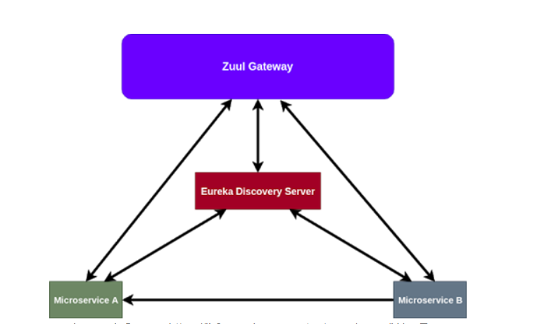
Edge Server - Netflix Zuul
Zuul is the front door for all requests from devices and websites to the backend. As an edge service application, Zuul is built to enable dynamic routing, monitoring, resiliency, and security. Routing is an important part of a microservice architecture.

Slide 16
Features
Spring Cloud focuses on providing good out of box experience for typical use cases and extensibility mechanism to cover others.
Distributed/versioned configuration
Service registration and discovery
Routing
Service-to-service calls
Load balancing
Circuit Breakers
Global locks
Leadership election and cluster state
Distributed messaging

Slide 17
Microservices
The microservice architectural style is an approach to develop a single application as a suite of small services.
Each microservice runs its process and communicates with lightweight mechanisms.
These services are built around business capabilities and independently developed by fully automated deployment machinery

Slide 18
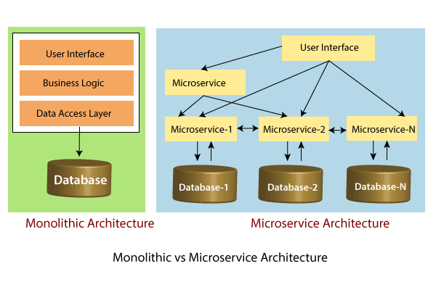

Slide 19
Principles of Microservices
Single Responsibility principle
Modelled around business domain
Isolate Failure
Infrastructure automation
Deploy independently

Slide 20
Advantages of Microservices
Microservices are self-contained, independent deployment module.
The cost of scaling is comparatively less than the monolithic architecture.
Microservices are independently manageable services. It can enable more and more services as the need arises. It minimizes the impact on existing service.
It is possible to change or upgrade each service individually rather than upgrading in the entire application

Slide 21
Disadvantages of Microservices
Microservices has all the associated complexities of the distributed system.
There is a higher chance of failure during communication between different services.
Difficult to manage a large number of services.
The developer needs to solve the problem, such as network latency and load balancing.
Complex testing over a distributed environment.

Slide 22
Challenges of Microservices Architecture
Bounded Context
Dynamic Scale up and Scale Down
Monitoring
Fault Tolerance
Cyclic dependencies
DevOps Culture

Slide 23
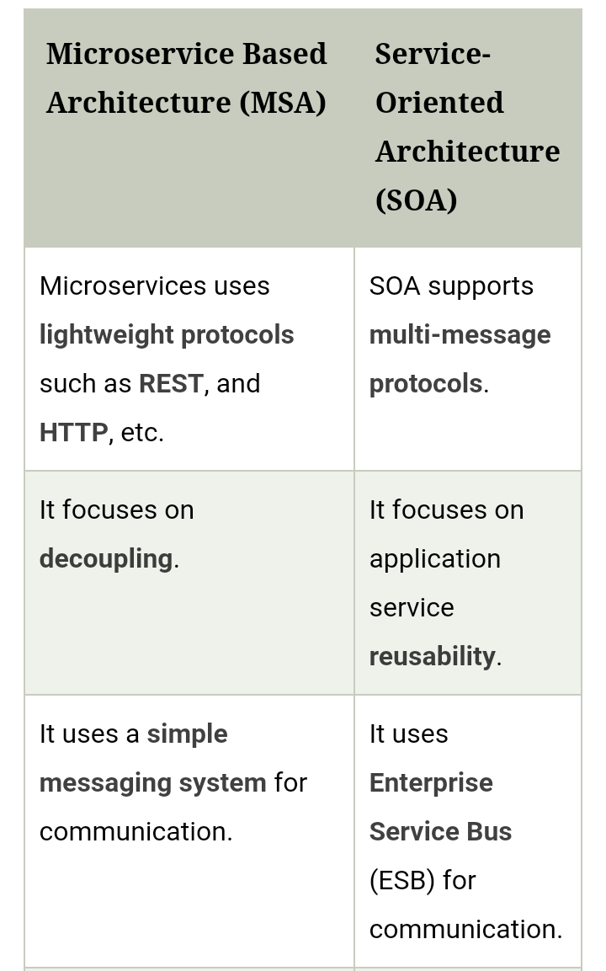
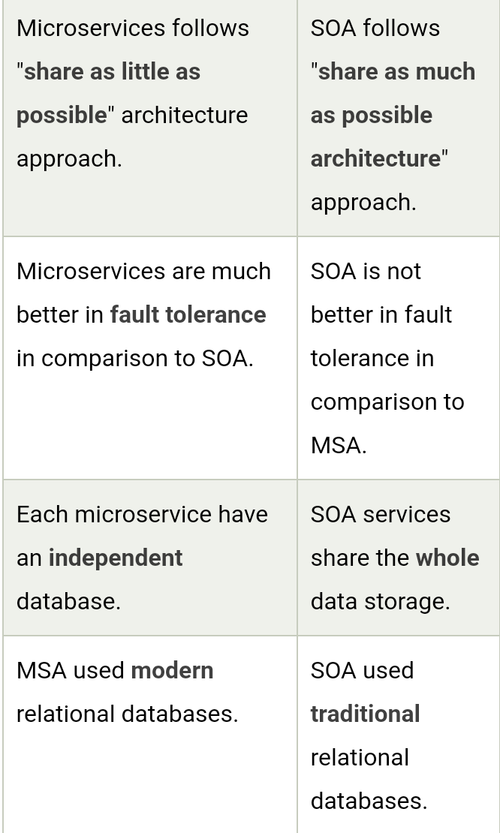

Slide 24
Microservices Monitoring
Monitor container and what's inside them.
Alert on service performance.
Monitor services that are elastic and multi-location.
Monitor APIs.
Monitor the organizational structure

Slide 25
There are three monitoring tools are as follows:
Hystrix dashboard
Eureka admin dashboard
Spring boot admin dashboard

Slide 26
Components of Microservices
There are the following components of microservices:
Spring Cloud Config Server
Netflix Eureka Naming Server
Hystrix Server
Netflix ZuulAPI Gateway Server
Netflix Ribbon
Zipkin Distributed Tracing Server

Slide 27
Spring Cloud Config Server
Spring Cloud Config Server provides the HTTP resource-based API for external configuration in the distributed system.
We can enable the Spring Cloud Config Server by using the annotation @EnableConfigServer.

Slide 28
Netflix Eureka Naming Server
Netflix Eureka Server is a discovery server. It provides the REST interface to the outside for communicating with it.
A microservice after coming up, register itself as a discovery client.
The Eureka server also has another software module called Eureka Client.
Eureka client interacts with the Eureka server for service discovery.
The Eureka client also balances the client requests.

Slide 29
Hystrix Server
Hystrix server acts as a fault-tolerance robust system. It is used to avoid complete failure of an application.
It does this by using the Circuit Breaker mechanism. If the application is running without any issue, the circuit remains closed.
If there is an error encountered in the application, the Hystrix Server opens the circuit.
The Hystrix server stops the further request to calling service. It provides a highly robust system.

Slide 30
Hystrix Server
Hystrix server acts as a fault-tolerance robust system. It is used to avoid complete failure of an application.
It does this by using the Circuit Breaker mechanism. If the application is running without any issue, the circuit remains closed.
If there is an error encountered in the application, the Hystrix Server opens the circuit.
The Hystrix server stops the further request to calling service. It provides a highly robust system.

Slide 31
Netflix Zuul API Gateway Server
Netflix Zuul Server is a gateway server from where all the client request has passed through. It acts as a unified interface to a client.
It also has an inbuilt load balancer to load the balance of all incoming request from the client.

Slide 32
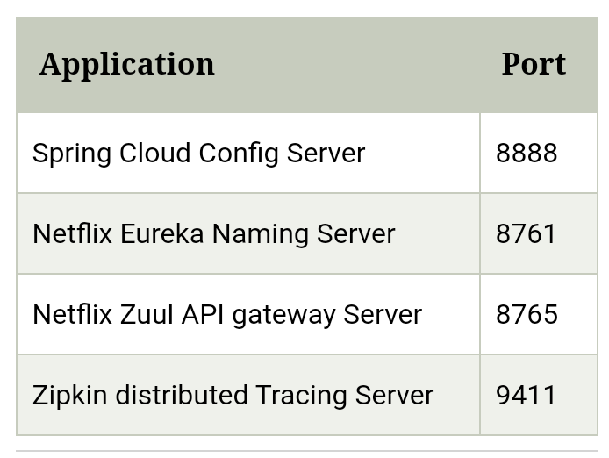

Slide 33
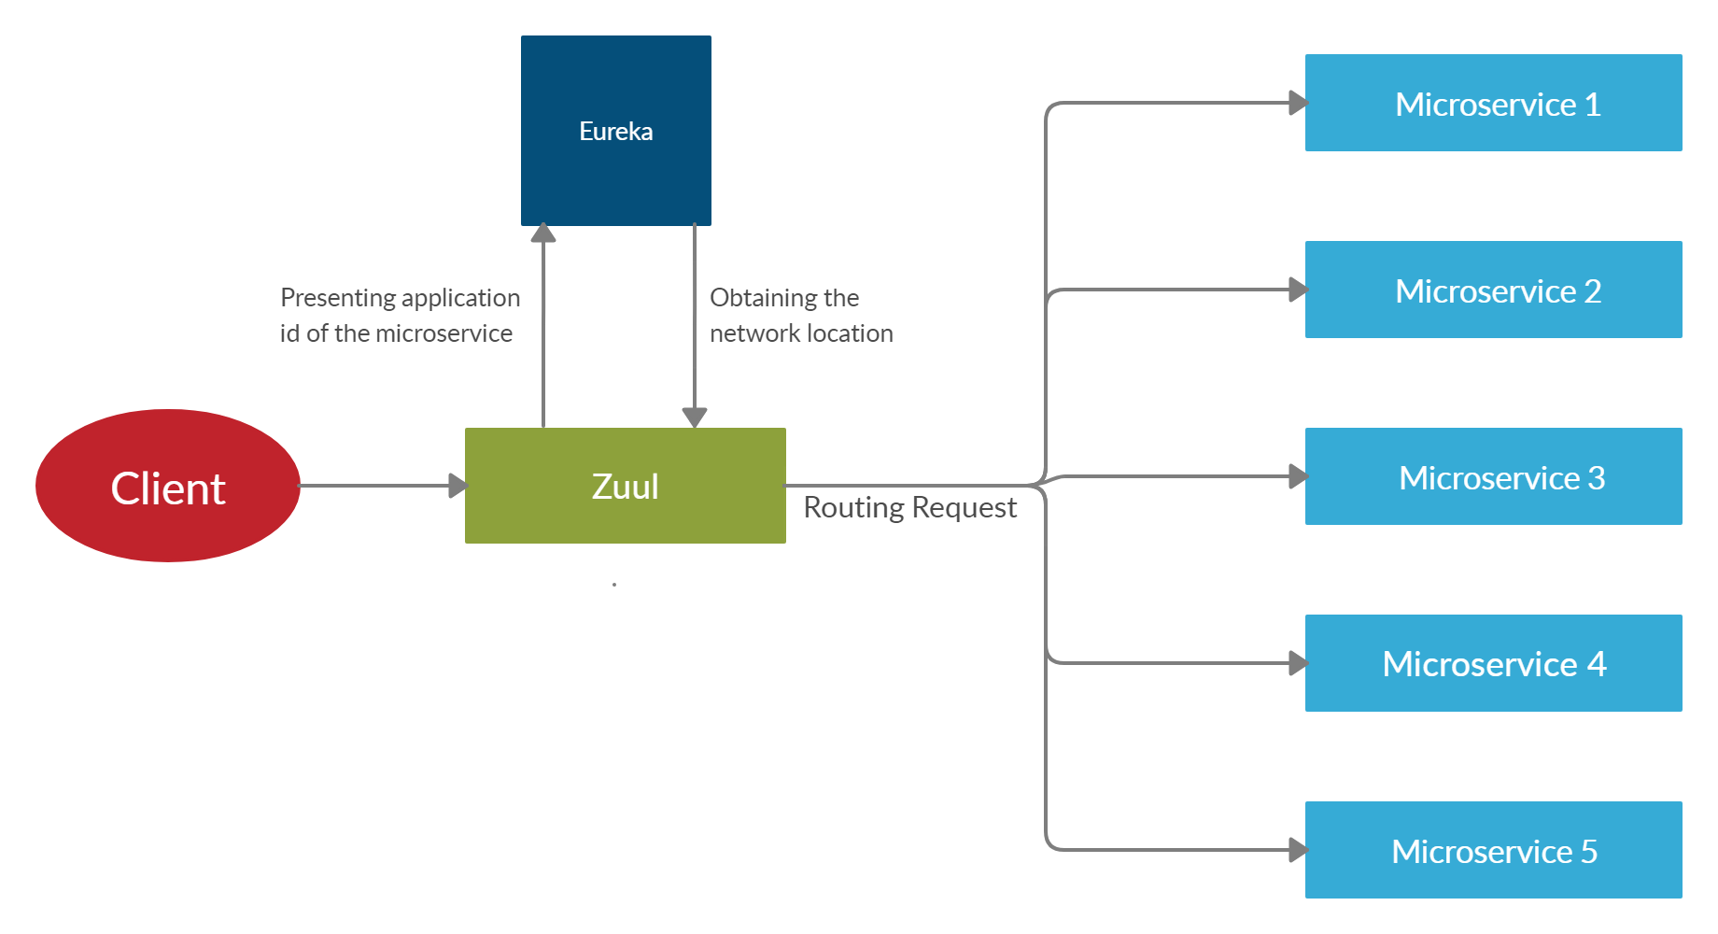

Slide 34
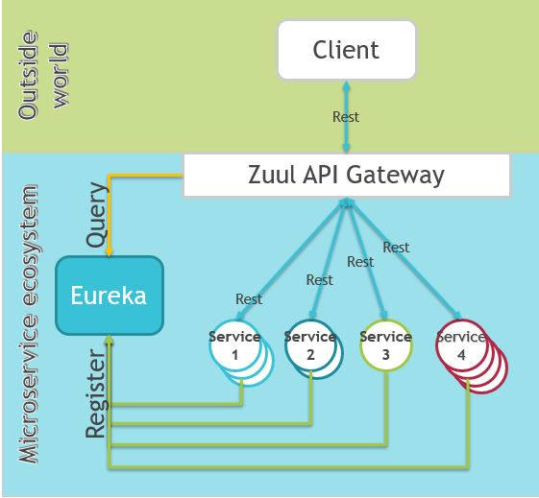

Slide 35
Sample coding

Slide 36
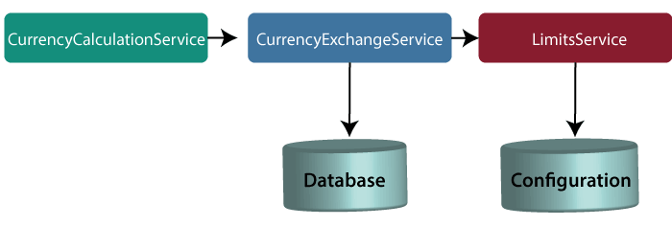

Slide 37
NetflixEurekaNamingServerApplication.java

Slide 38
NetflixEurekaNamingServerApplication.java
import org.springframework.boot.SpringApplication;
import org.springframework.boot.autoconfigure.SpringBootApplication;
import org.springframework.cloud.netflix.eureka.server.EnableEurekaServer;
@SpringBootApplication
@EnableEurekaServer
public class NetflixEurekaNamingServerApplication
{
public static void main(String[] args) {
SpringApplication.run(NetflixEurekaNamingServerApplication.class, args);
}
}

Slide 39
application.properties
spring.application.name=netflix-eureka-naming-server
server.port=8761
eureka.client.register-with-eureka=false
eureka.client.fetch-registry=false

Slide 40
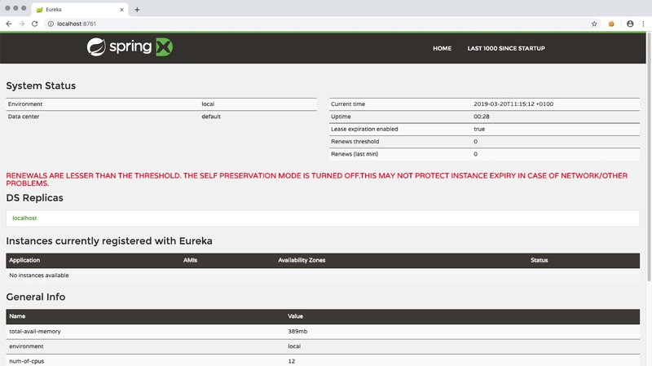

Slide 41
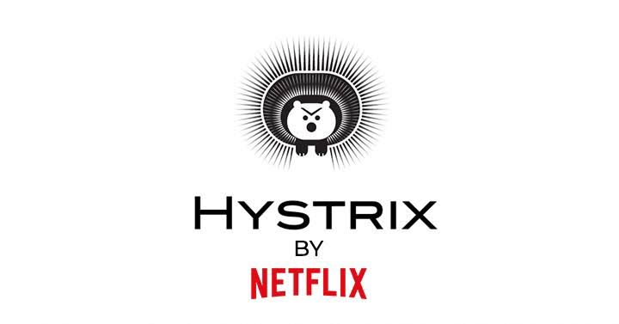

Slide 42

Hystrix Server
Hystrix server acts as a fault-tolerance robust system. It is used to avoid complete failure of an application.
It does this by using the Circuit Breaker mechanism. If the application is running without any issue, the circuit remains closed.
If there is an error encountered in the application, the Hystrix Server opens the circuit.
The Hystrix server stops the further request to calling service. It provides a highly robust system.

Slide 43
Fault Tolerance with Hystrix
Microservices must be extremely reliable because they depend on each other.
The microservice architecture contains a large number of small microservices.
These microservices communicate with each other in order to fulfill their requirements.
The instances of microservices may go up and down frequently.
As the number of interactions between microservices increases, the chances of failure of the microservice also increases in the system.

Slide 44
Fault Tolerance
Consider a scenario in which six microservices are communicating with each other.
The microservice-5 becomes down at some point, and all the other microservices are directly or indirectly depend on it, so all other services also go down.
The solution to this problem is to use a fallback in case of failure of a microservice. This aspect of a microservice is called fault tolerance

Slide 45
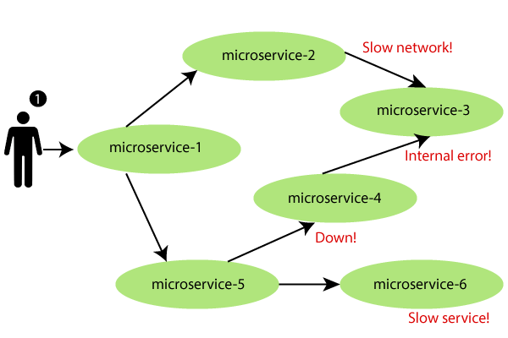

Slide 46
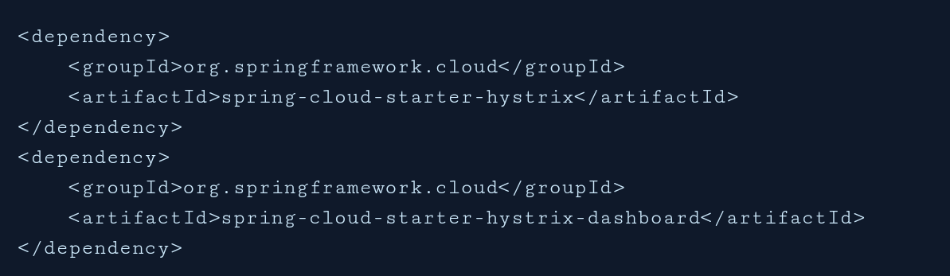
Hystrix configuration is done in four major steps.
Add Hystrix starter and dashboard dependencies
Add @EnableCircuitBreaker annotation
Add @EnableHystrixDashboard annotation
Add annotation @HystrixCommand(fallbackMethod = "myFallbackMethod")

Slide 47
Hystrix Circuit Breaker Pattern
Fault tolerance can be achieved with the help of a circuit breaker.
It is a pattern that wraps requests to external services and detects when they fail.
If a failure is detected, the circuit breaker opens.All the subsequent requests immediately return an error instead of making requests to the unhealthy service.
It monitors and detects the service which is down and misbehaves with other services. It rejects calls until it becomes healthy again

Slide 48
Hystrix Circuit Breaker Pattern – Spring Cloud
the Spring cloud Netflix stack component called Hystrix to implement circuit breaker while invoking underlying microservice.
It is generally required to enable fault tolerance in the application where some underlying service is down/throwing error permanently, we need to fall back to different path of program execution automatically.
This is related to distributed computing style of Eco system using lots of underlying Microservices. This is where circuit breaker pattern helps and Hystrix is an tool to build this circuit breaker.

Slide 49
Fallback method
The fallback method is a method that invokes when a fault occurs.
Hystrix allows us to define a fallback method for each service method

Slide 50
Sample coding

Slide 51
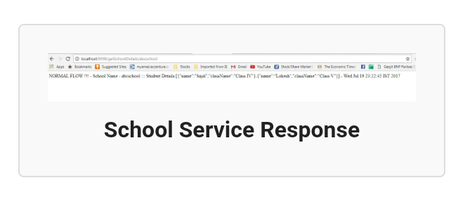

Slide 52
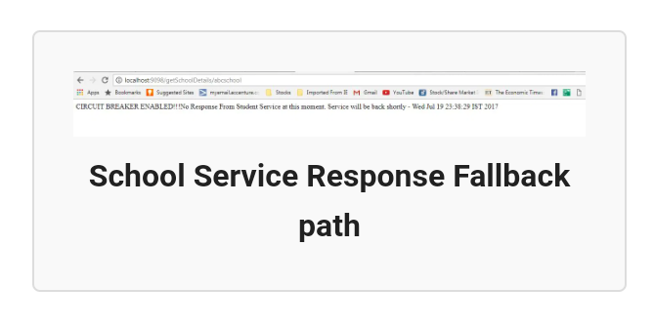

Slide 53
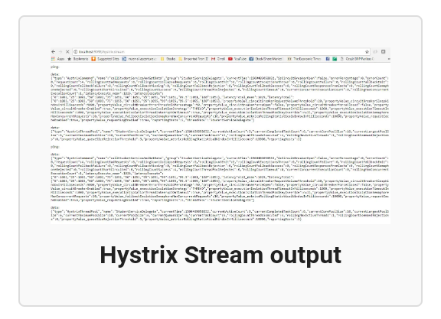

Slide 54
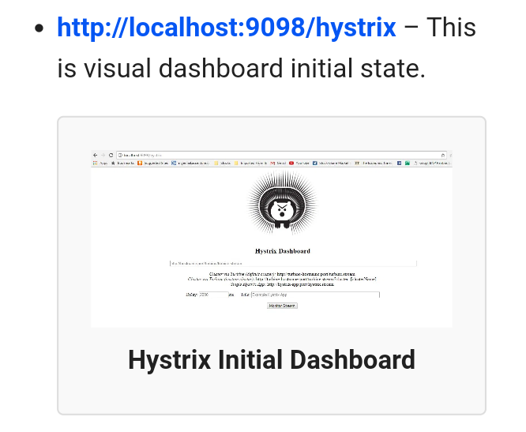

Slide 55
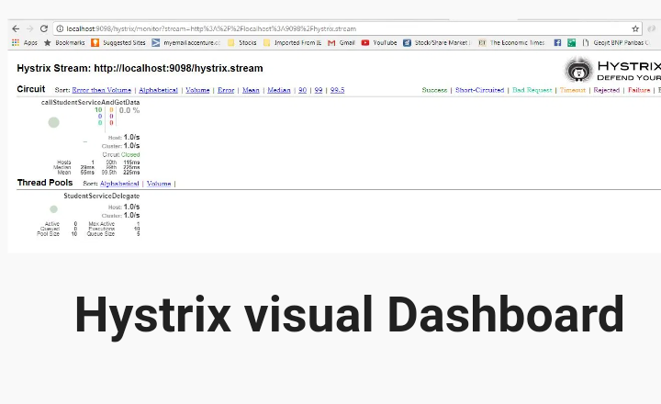

Slide 57
